Slide 1
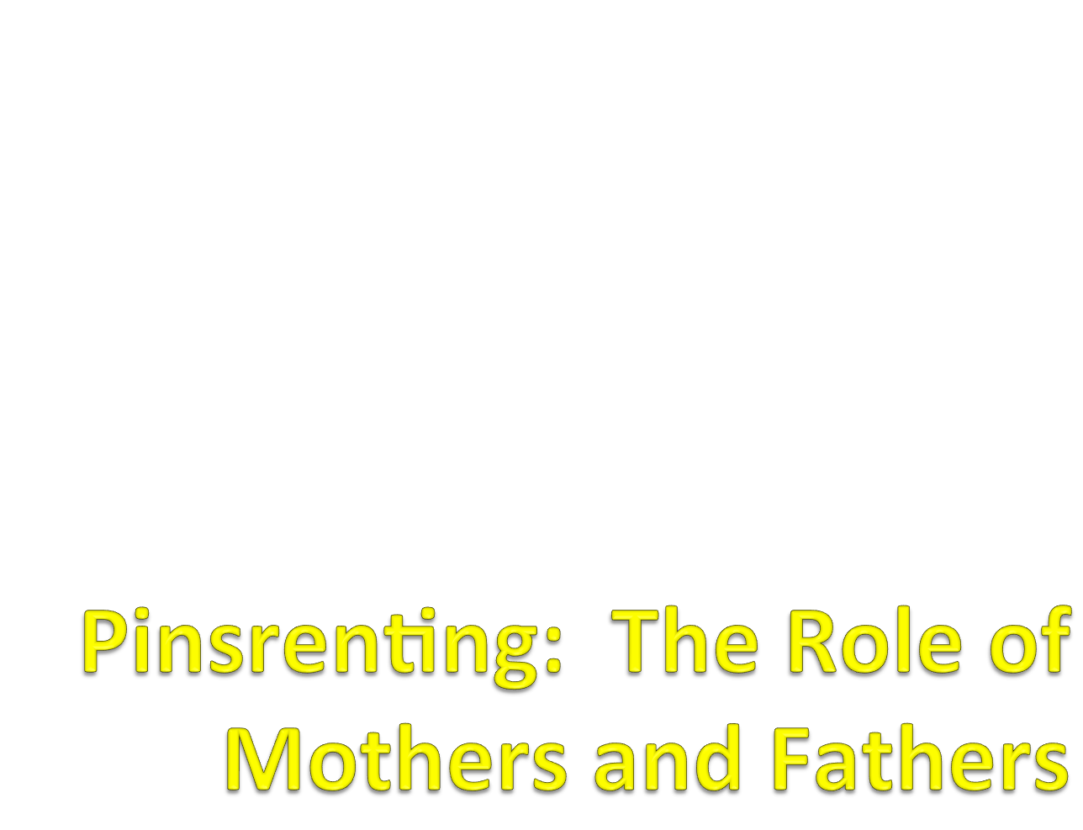

Slide 2
Research indicates that the role of a parent on child development is quite significant
Bi-directionality: a set of interactive processes whereby parents and children react to each other/ influence eachother
Research (both observational and experimental) has identified that children with difficult temperaments or behavior problems provoke more coercive responses (Bell, Parke and Clarke-Stewart)

Slide 3
Mothers and Fathers
  Industrialization led to long hours away from home/fields.
  Increased role differentiation—fathers seen more as economic providers than socializers/trainers
  Scholars promoted “women” natural caregiver given lactation

Slide 4
Psychology as a science focused on maternal influence on development; All major theories emphasized the maternal role
1960’s began to see some changes in research emphasis noted below

Slide 5
1. Attachment /Bonding literature led to question whether fathers had a role in socialization –results indicated strong relationship.
2. Shift in family structure which often resulted in a change in father-child relationship. Research on father absence, or father’s role when the mother was unavailable (surrogate caretaker)

Slide 6
3. Fathers became more active and vocal in their wishes/desires to be integral figures in their children’s life.
4. Although full-time and working mothers spend more time with their children, direct interaction seems less frequent than expected. Presence may involve cooking, reading, parallel activities

Slide 7
5. Amount of time spent not direct correspondence to influence
6. Infants are not passive recipients. Can distinguish mother/father and elicit different behaviors

Slide 8
1975 data: Mothers spent 9 waking hours in house with infant; Father’s average 3.2—some report as much as 8 hours and as little as 37 seconds.
2000 study: 64% mothers do majority; 25% share equally; 10% father; gay and lesbian parents appear to share tasks more equally
Fathers have increased contact with their children. In 1970’s fathers were about 1/3 as engaged compared to their mothers, in 2010 closer to 3/4 as engaged as their mothers (Pleck, 2010 in Parke and Clark-Stewart)

Slide 9
Father-child relationship investigated
  Identify when infant forms relationships with fathers and the similar and unique qualities of father-child relationship
  Both parents respond favorably to the child’s birth, are competent in caring for the newborn and adjust their speech patters when with their young children (motherese)

Slide 10
  Men and Women autonomic responses were similar to videotapes of distressed infants crying (Lamb)
  Mothers pick up babies in low-keyed manners establishing a predictable pattern and fathers activate babies, alternating strategies (Parke and Swain)

Slide 11
Men and women encourage their babies to solve problems.
Men tolerate more frustration on the infants part before moving obstacles then do the mothers; laugh and cry more
Mothers use more toy mediated play/learning and men engage in more rough and tumble play (Biller and Meredith)

Slide 12
Children learn through parental dyad interactions; learn how to behave in the social world
  Children exposed to hostile-competitive co-parenting are more likely to be aggressive
  Children exposed to cooperative co-parenting show positive social-emotional development (in Parke, Clark-Stewart)

Slide 13
Parenting advice regarding sleep changed as we learned more about child development (Spock, Leach, Ferber)
  Co-sleeping: cultural variations
  Sleep difficulties as a reflection of attachment problems or developmental shifts (When the Bough Breaks)

Slide 14
Pederson and Robson looked at reunion behaviors and found most infants appear to be attached to both parents by 8 months of age
In stress-free situations infants show no parental preference
When stressed they organize around parent who is present

Slide 15
Differential roles
  From infancy fathers engage in more physically stimulating and playful interactions
  Mothers engage in conventional play, caretaking
  This pattern continues through adolescence with fathers more likely to joke, tease
  May be some cultural influences on these behaviors (in Parke, Clark-Stewart)

Slide 16
Research finds fathers are more “instrumental”
( mastery and competence) and mothers are more
“expressive” (relationships; emotional support)
Children’s perceptions of parenting behaviors: often see mothers as more nurturing, fathers as more playful as well as threatening or demanding

Slide 17
Lamb’s caution: mothers do play; not as proportionate to other things they do
When fathers are supportive and encouraging: mothers are more patient, flexible, emotionally responsive, sensitive, and available to their infants and young children
* The Effects of Father Involvement: An Updated Research Summary of the Evidence Inventory © Centre for Families, Work & Well-Being, University of Guelph 2007 )

Slide 18
Mothers seen as promoting nurturance, verbal, and intellectual skills
Fathers encourage independence: paternal care has been shown to increase resiliance, is associated with curiosity and willingness to explore the environment and react more competently to complex and novel stimuli

Slide 19
Emotional Development:
Maternal reactions can impact feelings of self-consciousness.
Mother’s who emphasize the negative by being critical of failures had children with high levels of shame and little pride after success
Mother’s who praise successes have children more likely to show pride in accomplishments, less shame when failing

Slide 20
Social Referencing: parents’ emotional expressions and reactions to ambiguous information provide a guide to a response.
Children learn about themselves and ways they should react to the world in this way.
Other referents exist: siblings, peers, tv

Slide 21
Achievement and Intellectual Development
  Fathers involvement shows mixed results. Middle class boys with nurturing fathers excel as they read more, and encourage curiosity
  Highly involved fathers have a marked impact on daughters cognitive development
  Both fathers and mothers encourage achievement more in boys than girls

Slide 22
  Paternal encouragement is related to achievement; paternal rejection impairs achievement
  Fathers with low expectations and close relationships inhibits performance

Slide 23
Social Competence:
  Warm father-son relationships lead to greater social competence; self-esteem and adjustment
  Warm father-daughter relationships linked with self-esteem and positive male-female relationships
  Research has found a direct influence of men’s participation in childcare for children’s prosocial development among three year olds (Kato et al., 2002)*.

Slide 24
Display Rules: mothers and fathers increasingly teach their children about the ways to express and suppress emotions.
By age 3 children show some limited ability to hide feelings.
Girls are more motivated and more skilled at complying with display rules

Slide 25
Children become more complex in the ability to label emotional states

Slide 26
Gender Identity:
  Maccoby and Jacklin: mens language and physical handling style shift for boy/girl infants and children
  Men were more likely to touch and vocalize with infant sons; spend more time sharing play, playing on the floor with sons (Weinraub and Frankel)

Slide 27
Studies on Altruism:
Studies have shown that one of the most powerful predictors of empathy in childhood and adulthood was how much time the children’s father spent with them
Children who saw their fathers as sensitive, caring beings were more likely to grow up that way. Paternal involvement is associated with both prosocial and moral behavior in sons and daughters.

Slide 28
Primary Caregiver Fathers (PCF’s)
  Fathers who stay home have lower gender stereotypes, more friendly personalities, more sympathetic and find parenthood enriching
  Qualitative research (West et. al., 2008) shows various reasons for PCF’s including earning power, child care alternatives, parental history
  Children raised primarily by fathers were active and competent with the majority above norms in problem solving and social adaptation (Pruett)

Slide 29
Children of Gay and Lesbian Parents (2012, APA)
  Patterson’s and others research findings summarized the literature for the APA
    “On the basis of a remarkably consistent body of research on lesbian and gay parents and their children, the American Psychological Association (APA) and other health professional and scientific organizations, have concluded that there is no scientific evidence that parenting effectiveness is related to parental sexual orientation. That is lesbian and gay parents are as likely as heterosexual parents to provide supportive and healthy environments for their children. This body of research has shown that the adjustment, development and psychological well-being of children are unrelated to parental sexual orientation and that children of gay and lesbian parents are as likely as those of heterosexual parents to flourish”

